Slide 1
DevOps tools

Slide 2
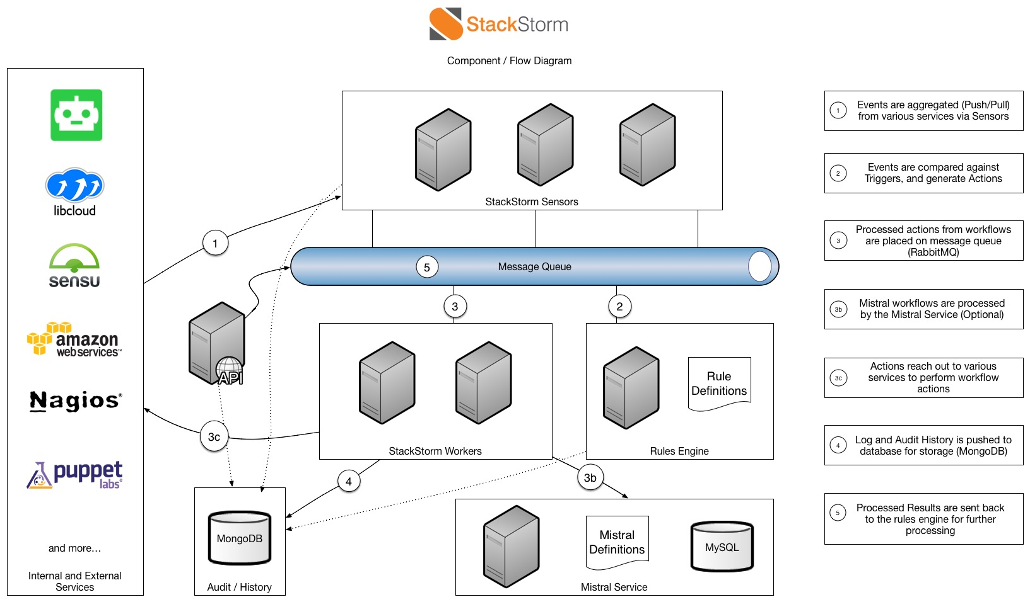
StackStorm
StackStorm is a platform for integration and automation across service and tools. It ties together your existing infrastructure and applications environment for automation. For more information, https://docs.stackstorm.com/overview.html#about.

Slide 3
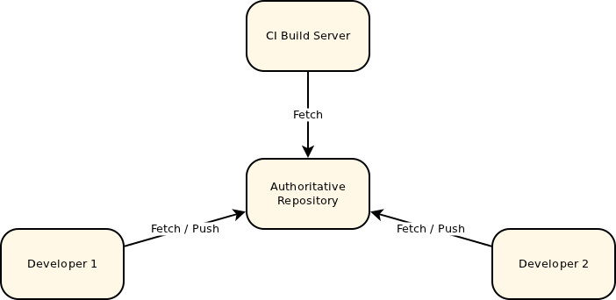
Gerrit
Gerrit is a web-based code review tool built on top of the git version control system. More information here https://review.openstack.org/Documentation/intro-quick.html

Slide 4
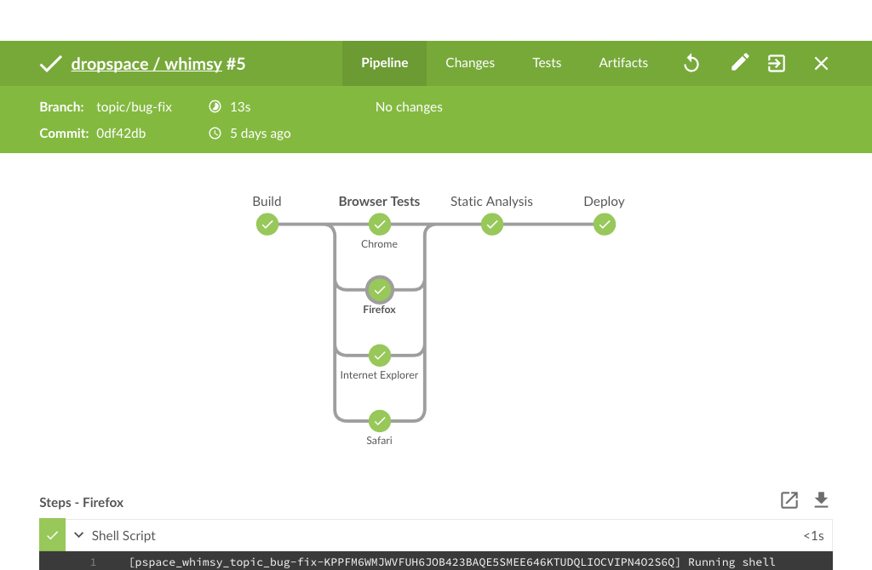
CI
Jenkins is a self-contained, open source automation server which can be used to automate all sorts of tasks related to building, testing, and delivering or deploying software. https://jenkins.io/

Slide 5
Artifactory
Artifactory is a product by JFrog that serves as a binary repository manager. That said very often one will use an artifactory as a synonym of the more general binary repository, much like many people use Frigidaire or fridge to denote the refrigerator regardless if it is a Frigidaire brand or not.
The binary repository is a natural extension to the source code repository in that it will store the outcome of your build process, often denoted as artefacts. Most of the times one would not use the binary repository directly but through a package manager that comes with the chosen technology.
The binary repository can allow to host under one roof all of these making their management much simpler for teams.

Slide 6
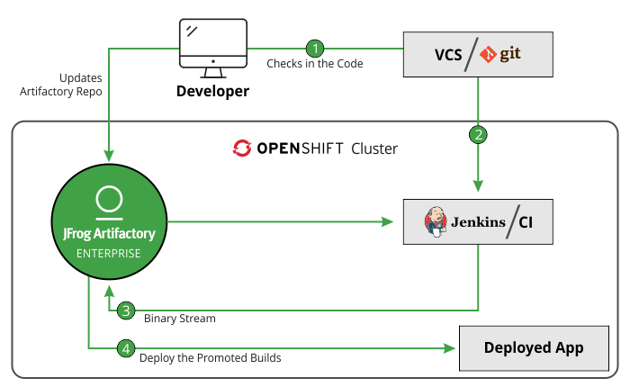
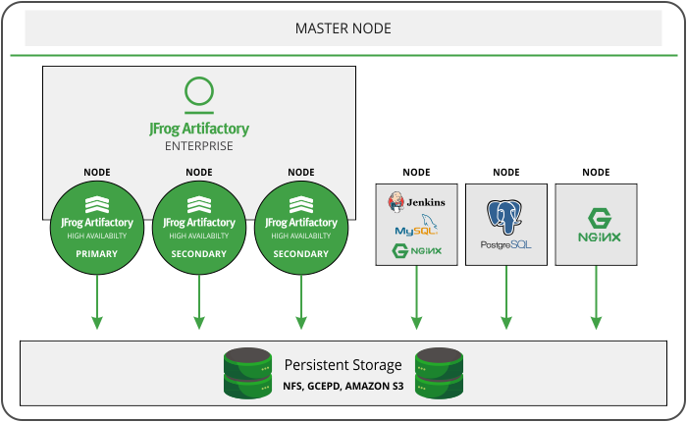
Artifactory continued

